Slide 1
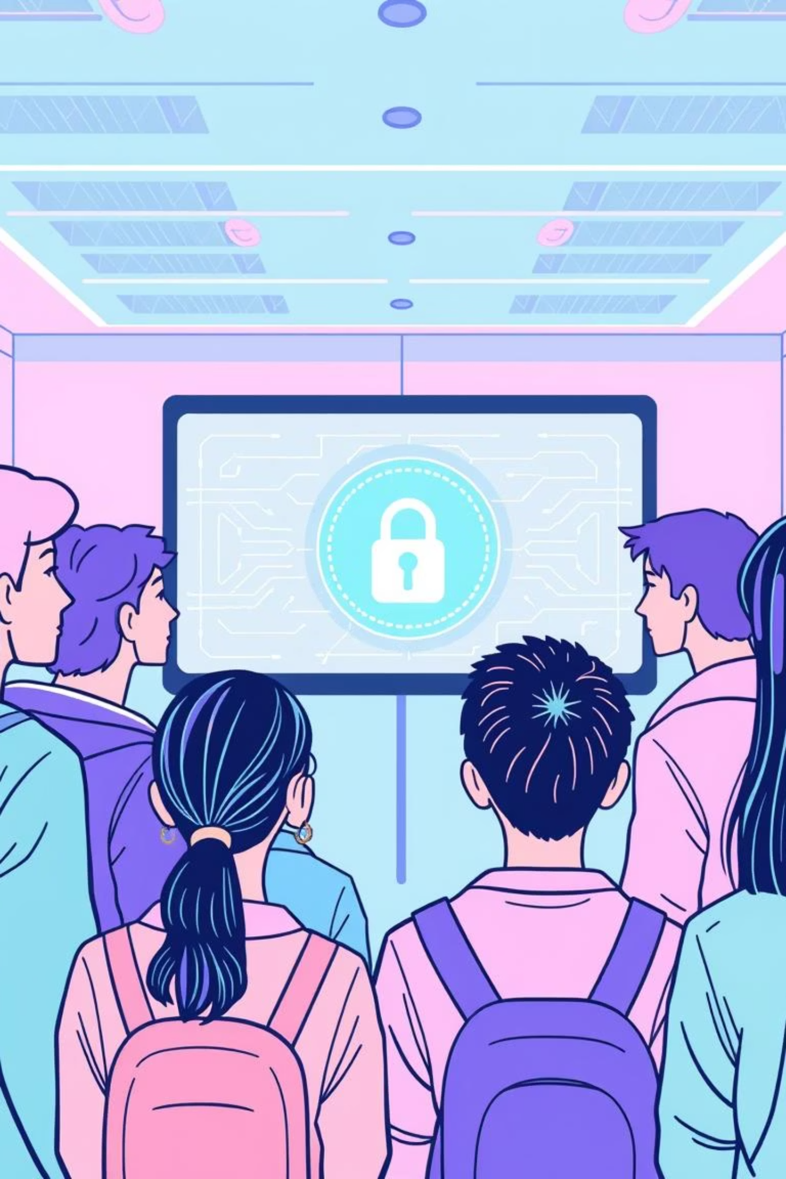
Phishing Awareness Training: Defend Yourself Against Cyber Deception
Welcome to this essential training module designed for undergraduate and graduate students.

Slide 2
Why Phishing Matters
The Growing Threat in a Connected World
36%
33M
1/3
of all data breaches in 2023 involved phishing (Verizon DBIR), highlighting its pervasive impact on organizational security.
records stolen via phishing attacks in 2023 (Splunk), emphasizing the massive scale of data compromise.
of users fall victim to phishing attempts (CyberReady), underscoring the critical need for heightened individual awareness.
Phishing remains the #1 cyber attack vector, favored by attackers for its simplicity and high return on investment. Understanding this landscape is the first step in building a robust defense.

Slide 3
Spotting the Deception
Recognizing Phishing Emails: Red Flags
Unexpected or Urgent Requests
Suspicious Sender Details
Emails demanding immediate action or secrecy, often creating a sense of panic to bypass critical thinking. Always question unsolicited urgency.
Email addresses that are slightly altered from legitimate ones (e.g., "supp0rt@bank.com" instead of "support@bank.com") or appear to be spoofed from a known contact.
Generic Greetings & Poor Quality
Dubious Links or Attachments
Lack of personalized salutations ("Dear Customer" instead of "Dear [Your Name]"), along with noticeable grammar mistakes, spelling errors, or inconsistent branding that doesn't match the purported sender.
Hover your mouse cursor over any embedded links to preview the actual URL before clicking. Be wary of unexpected attachments, especially if they are executable files (.exe) or compressed archives (.zip).

Slide 4
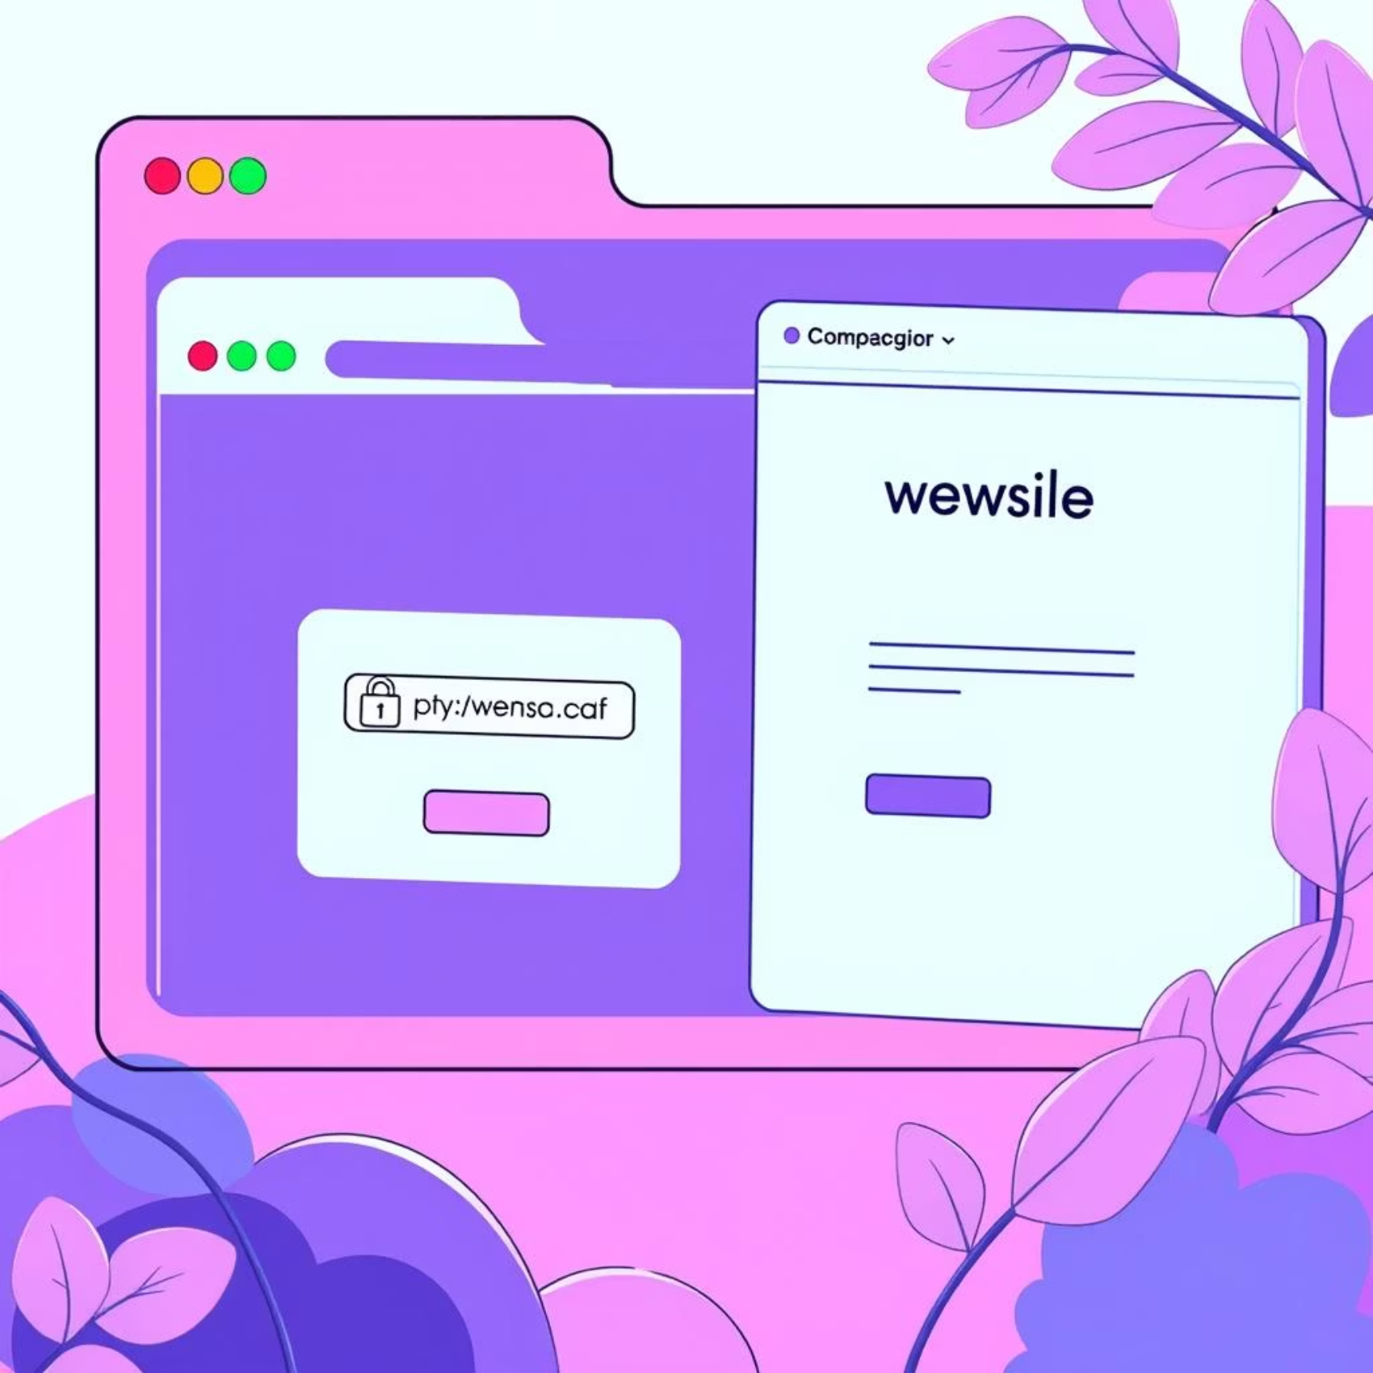
Verify Before You Proceed
Identifying Fake Websites: Don't Take the Bait
Mismatched or Unusual URLs: Look for misspellings, extra characters, or domains that don't match the company (e.g., ".xyz" or ".info" instead of ".com" or ".org").
No HTTPS or Invalid Certificates: The absence of "https://" in the URL or a warning about an invalid security certificate is a major red flag. Always look for the padlock icon.
Design Inconsistencies: Low-quality images, outdated logos, or a general unprofessional appearance can indicate a fraudulent site.
Unusual Information Requests: Be suspicious if a website, especially one that doesn't usually, asks for highly sensitive information like your social security number or full credit card details outside of a secure checkout process.
Always type known URLs directly into your browser's address bar rather than clicking on links from emails or untrusted sources.

Slide 5


Beyond Technology
Social Engineering Tactics: Attack Your Mind
Urgency & Fear
Impersonation
Attackers create a false sense of urgency or fear (e.g., "Your account will be locked!") to rush victims into making impulsive decisions without thinking.
They pretend to be trusted sources such as your bank, employer, IT department, or a government agency to gain your trust and compliance.
Pretexting
Multi-Channel Attacks
Attackers invent a convincing scenario or story to extract specific information (e.g., "We need your password to fix an urgent system issue").
Phishing isn't just email. It can involve phone calls (vishing), SMS messages (smishing), or even social media messages, all designed to trick you into divulging information.

Slide 6





Your Proactive Defense
Best Practices to Avoid Falling Victim
Verify All Requests
If you receive an unexpected request for information or action, always verify it through official channels (e.g., call the organization using a number from their official website, not the email).
Protect Your Credentials
Never share passwords, personal identification numbers (PINs), or other sensitive information via email, text, or unsolicited phone calls. Legitimate organizations will never ask for this.
Enable Multi-Factor Authentication (MFA)
Use MFA whenever possible. This adds an extra layer of security, requiring a second verification step (like a code from your phone) even if your password is compromised.
Keep Software Updated
Regularly update your operating system, web browsers, and all software with the latest security patches. This helps protect against known vulnerabilities that attackers exploit.
Report Suspicious Activity
If you encounter a suspicious email, text message, or website, report it immediately to your IT or security team. Your vigilance helps protect the entire community.

Slide 7
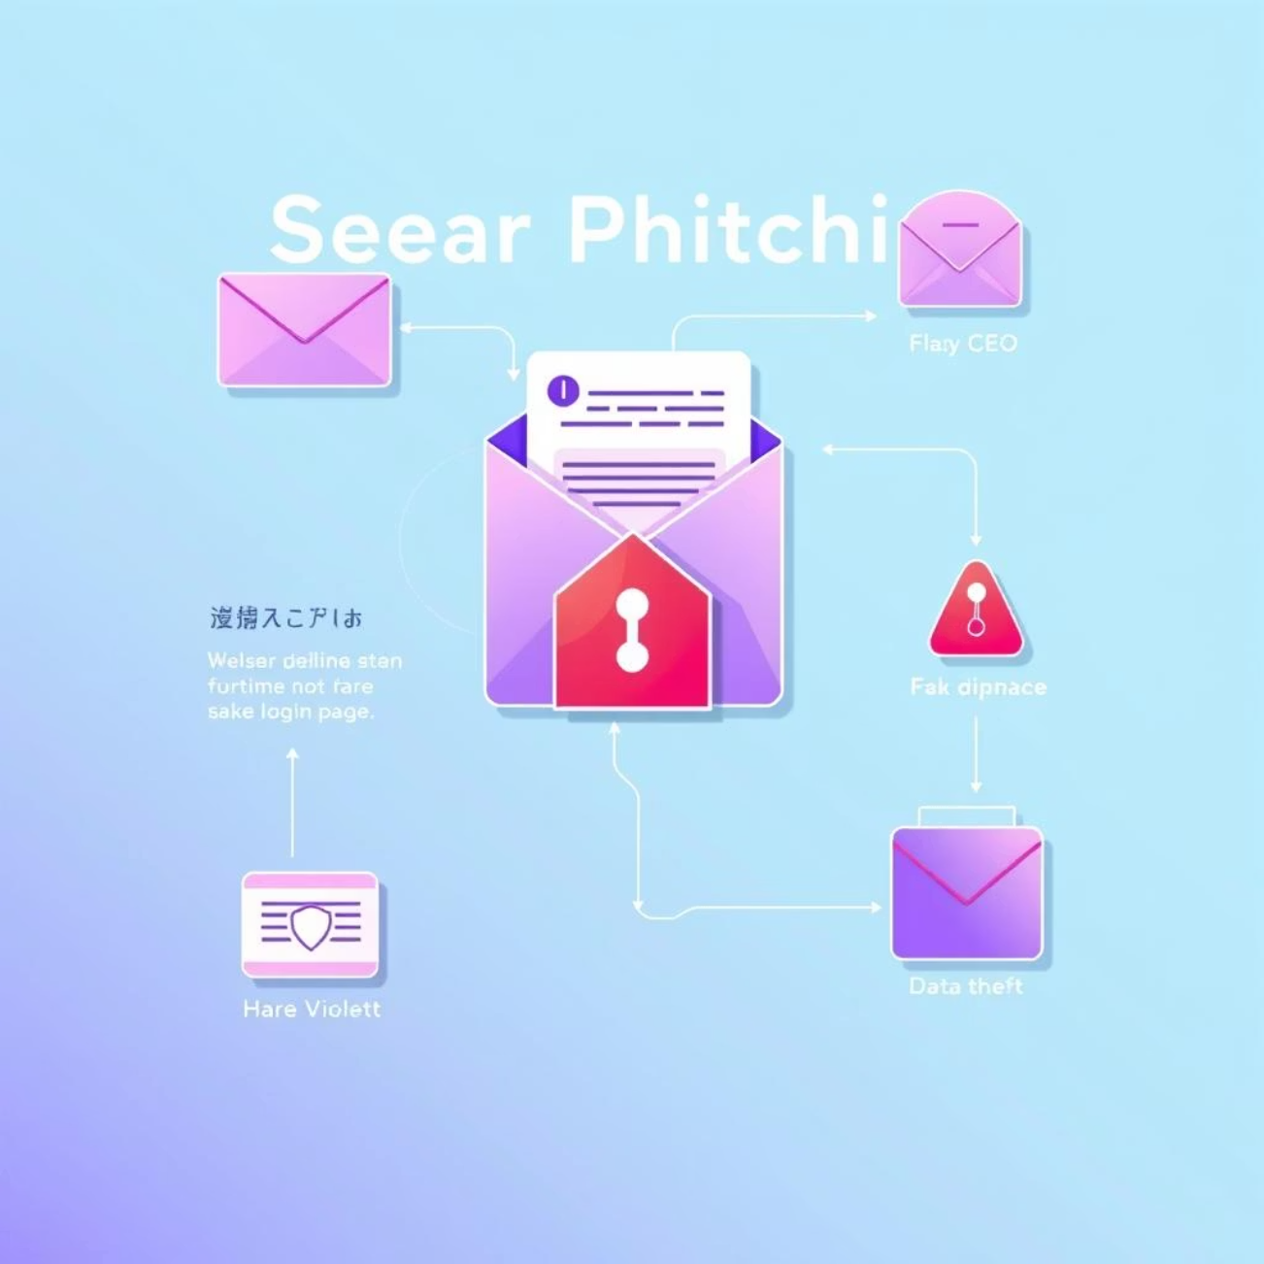
Lessons Learned
Real-World Example: Acme Corp Spear Phishing Attack
In 2023, Acme Corp experienced a sophisticated spear phishing attack. Attackers carefully crafted emails impersonating the CEO, requesting an urgent wire transfer. Unfortunately, a well-intentioned employee clicked on a malicious link and entered their credentials on a fake website.
This incident resulted in a significant financial loss of $1.2 million and a data breach affecting 10,000 customer records. It highlighted the critical need for enhanced awareness and robust security protocols.
Following the attack, comprehensive and targeted training was implemented, focusing specifically on recognizing spear phishing tactics. Within six months, the organization saw an 80% reduction in similar incidents, demonstrating the power of education and vigilance.

Slide 8
Put Your Knowledge to the Test
Interactive Quiz: Test Your Phishing Smarts!
1
2
3
You receive an email from your bank asking you to confirm your password via a link provided in the email. What do you do?
Your CEO emails you urgently, requesting payroll information for a new project. How should you respond?
You notice a website's URL where the ".com" has been replaced by ".co". Is this site safe to enter your personal details?
(Answers and key takeaways will be revealed on the next slide!)

Slide 9
Reinforce Your Knowledge
Quiz Answers & Key Takeaways
Q1: Bank Password Request
Q3: Suspicious URL (.co)
Answer: Do NOT click the link. Legitimate banks will never ask for your password via email. Instead, contact your bank directly using their official website or the phone number on your bank statement.
Answer: Likely a phishing site. This is a common tactic to trick users. Always double-check URLs carefully for misspellings, strange domains, or subtle alterations. If in doubt, type the correct URL yourself.
Q2: Urgent CEO Request
Remember:
Answer: Always verify unexpected urgent requests by contacting the sender through a known, alternative communication channel (e.g., call the CEO or their assistant directly using an official company number, not replying to the email).
When in doubt, pause and verify. A moment of caution can save you from significant cyber threats. Never click or share sensitive information unless you are absolutely certain of the source.

Slide 10




Your Commitment to Security
Your Role in Cyber Defense: Stay Alert, Stay Safe
Evolving Threats
Continuous Learning
Phishing attacks constantly evolve, so your awareness must too.
Regular training and simulations build stronger defenses.
Report & Protect
Human Firewall
Reporting suspicious activity helps protect everyone.
Together, we create a robust human firewall against cyber threats.
Let’s commit to vigilance and protect our organization today. Thank you.

